Slide 1
Electronic System Design ELC 4001
” وما بكم من نعمة فمن الله “
Final Project
2024
Prof. Serag E. D. Habib

Slide 2

Project Objective
Design a Modular Array for Multiplication & Division
Features:
* Unsigned binary numbers
* Multiplier Mode : 5bit * 5 bit
* Divider Mode: 10 bit $÷\text{5 }\text{bit}$
* Objective: maximum speed

Slide 3
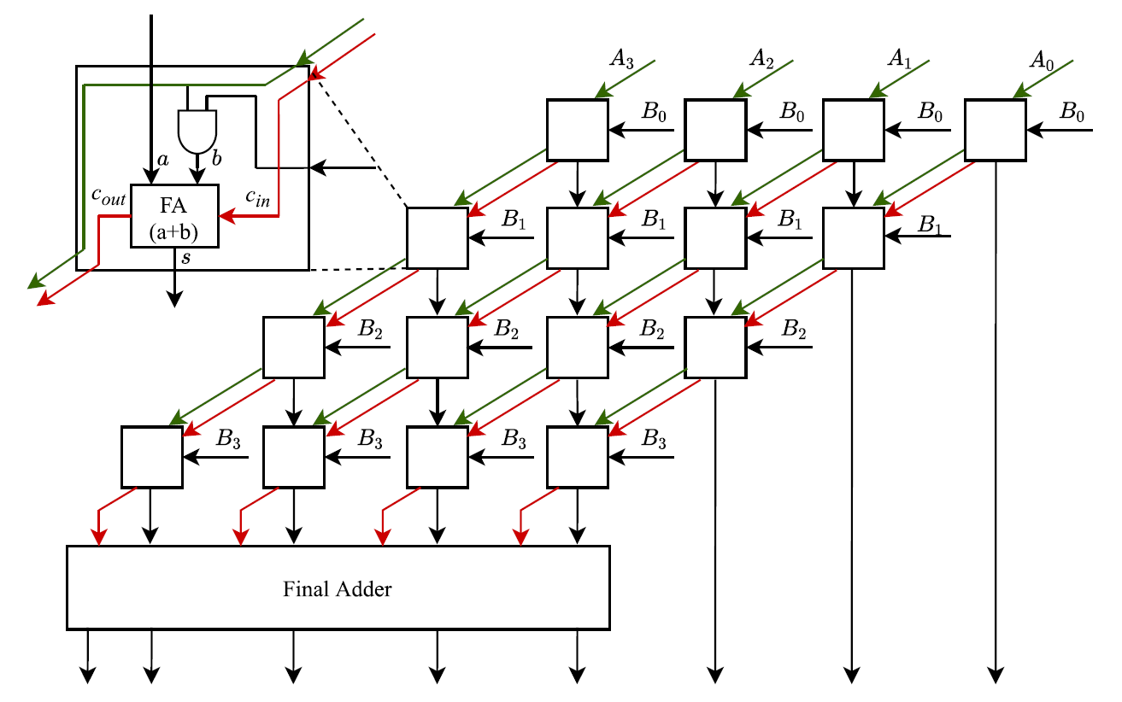
Project Subject / Array Multiplier
Array Binary Multiplier Circuit

Slide 4
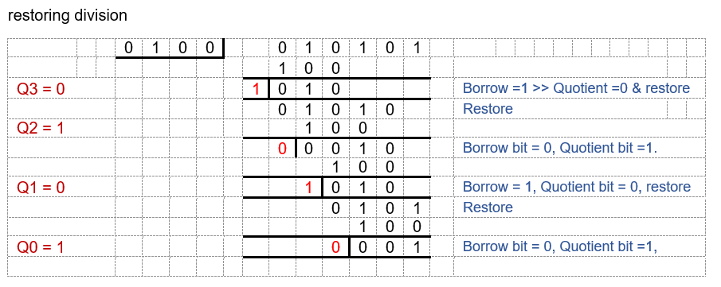

Project Subject / Array Divider
Array Binary Division Circuit
$$F = \frac{A}{D} = Q + \frac{R}{D}$$
Pencil and paper division:
Successive subtractions / additions
division algorithm includes decision boxes
Example – Restoring division algorithm: Divide 21 / 4
Quotient = 101 Remainder = 1

Slide 5
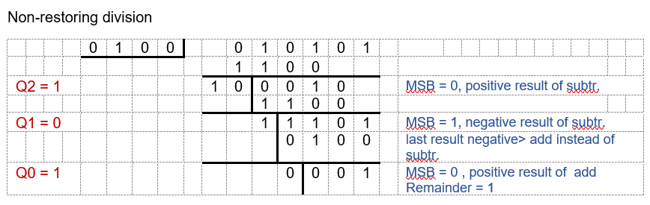
Project Subject / Array Divider
Non-restoring division algorithm: Divide 21 / 4
Quotient = 101 Remainder = 1

Slide 6
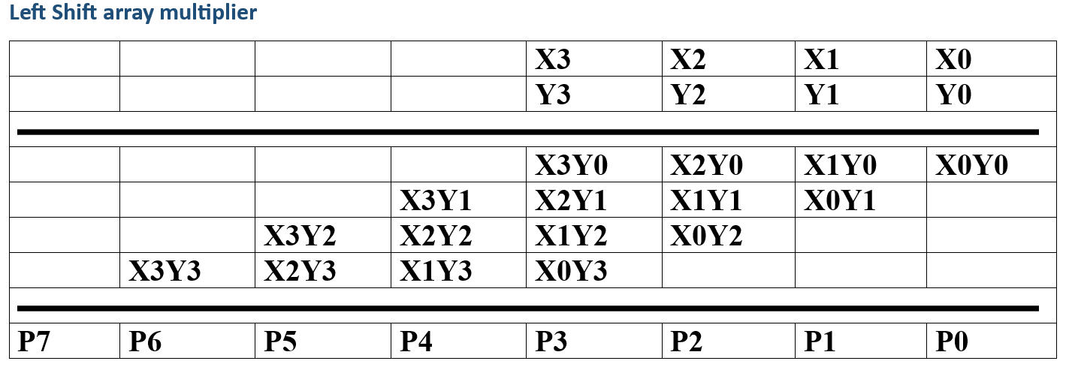
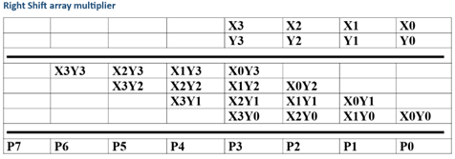
Project Subject / Array divider
Left shift & Right Shift array Multipliers

Slide 7
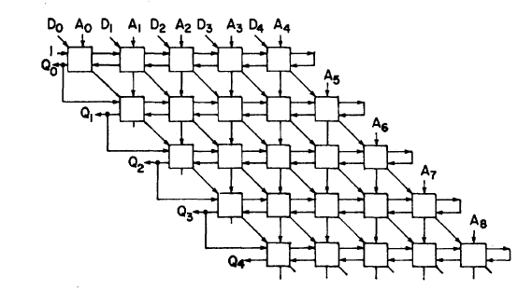
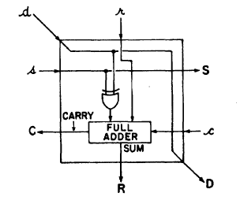
Project Subject / Array Divider
Structure of non-restoring array divider
Note: D0 is the MSB of dividend

Slide 8
CUSCLIB Standard cell Library
Cairo University Standard Cell Library (CUSCLIB):
0.5 µm Scalable Nwell CMOS process
104 Standard cells developed by previous students of this course
Examples :
Gate | description | W/L for NMOS Tr. | W/L for PMOS Tr.
NAND | 2 input Nand Gate | 1/1 | 1/1
NAND | 2 input Nand Gate | 1/1 | 2/1
NAND | 2 input Nand Gate | 1/1 | 3/1
Xor | 2 input Xor Gate | 1/1 | 1/1
AND-OR-INVERT | 2-Input AND into 2-Input NOR | 1/1 | 1/1
Majority | Majority (AB+AC+BC) | 1/1 | 3/1
Multiplexer | 2:1 multiplexer | 1/1 | 1/1
1 bit Comparator cell | Equality output | 1/1 | 1/1
ADDER | Half adder | 1/1 | 2/1
D-FF | Slave cell of static D FF
D-FF | Master cell of static D FF

Slide 9
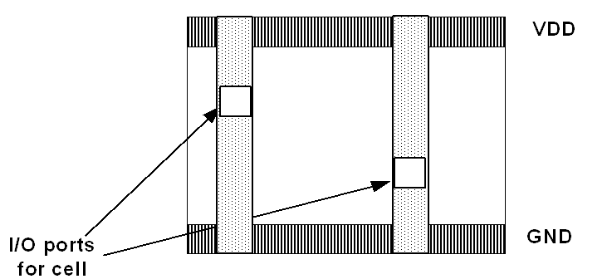
CUSCLIB Standard cell Library
Each standard cell satisfies the following guidelines:
i ) Cell height 40 λ
ii ) VDD runs on a 5λ strip of Metal 1 located at height 34.5 λ to 39.5 λ
iii ) GND runs on a 5λ strip of Metal 1 located at height 0.5 λ to 5.5 λ
iv ) Inputs and outputs of each cell are available via vertical Metal 2 wires

Slide 10
IO cells and Pads
Min. functionality required from digital I/P cell
i ) Latch
ii ) level protection
Min. functionality required from Digital O/P cell
i ) Tri-state buffer
ii ) High current drive

Slide 11
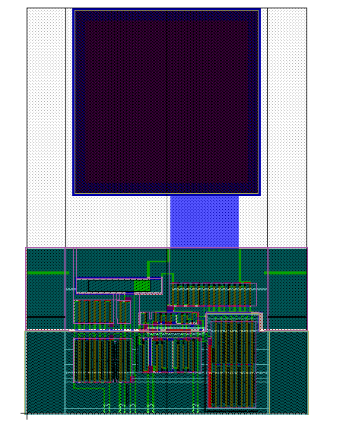
IO cells and Pads
Pad
I/O cell

Slide 12
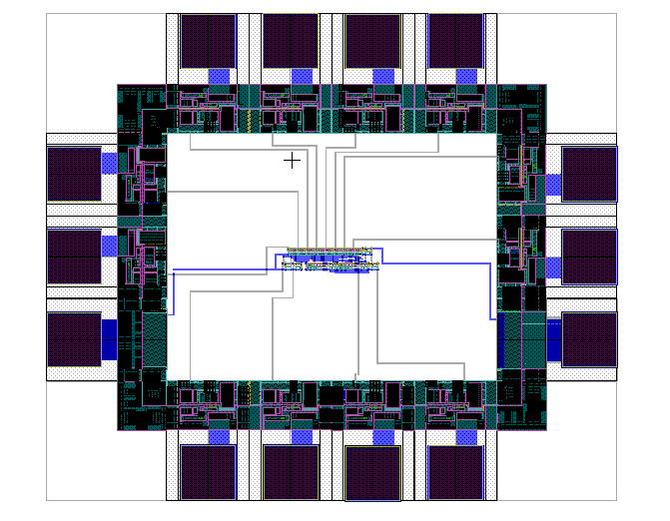
Full layout
Corner cell
Gnd I/P cell and Pad
V_{DD} I/P cell and Pad
Remember: I/O cells require VDD and Gnd power lines !!
When IO cells are abutted, VDD and GND cells create power ring around the chip that supplies power to all IO cells

Slide 13
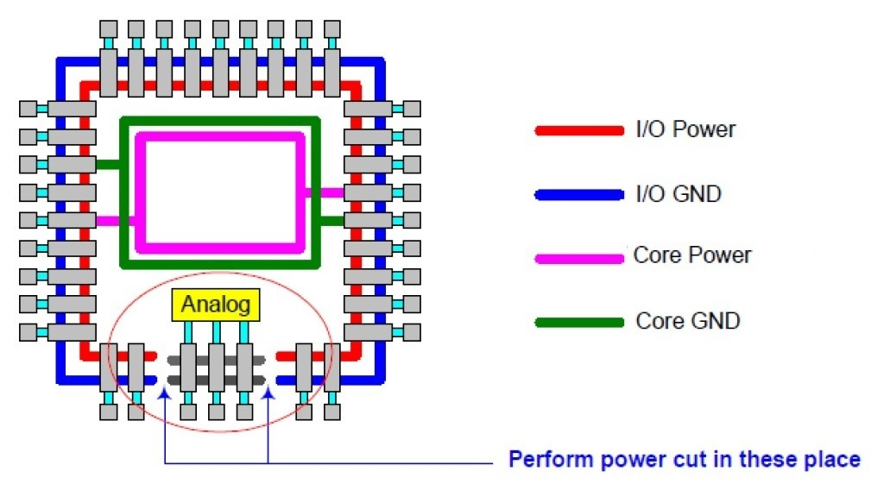
Full layout

